Slide 1








File System Extension
/
Places
Recent
Home
Desktop
Documents
Downloads
Music
Pictures
Videos
Trash
Devices
Computer
Network
Connect to Server
work
private
13.06.2024
Anna Pietzak, Timothy Roberts
Operating Systems FS24

Slide 2


/File System Extension/Problem.txt
Places
Recent
Home
Desktop
Documents
Downloads
Music
Pictures
Videos
Trash
Devices
Computer
Network
Connect to Server
We have only one device for all parts of our live.
Holiday Pictures
CS Exercises
Work hours

Slide 3

/File System Extension/Solution.c
Places
Recent
Home
Desktop
Documents
Downloads
Music
Pictures
Videos
Trash
Devices
Computer
Network
Connect to Server
Name
Date
Type
Tag
Holiday Pictures
30.12.2023
folder
private
CS Exercises
01.04.2024
folder
education
Add (multiple) tags to files
Remove tags from files
Keep track of allowed tags
Search files by tags in directory and subdirectory
Work hours
27.03.2024
folder
work
We can extend our file system to allow for further categorisation of our files.
That way we can selectivly display only files related to our current activity.

Slide 4
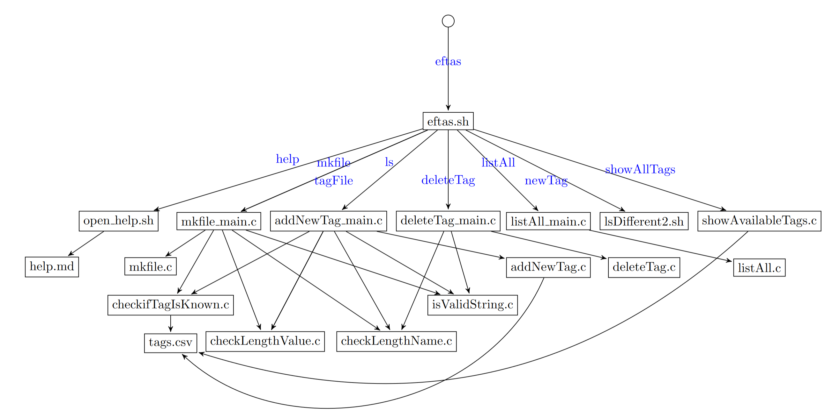
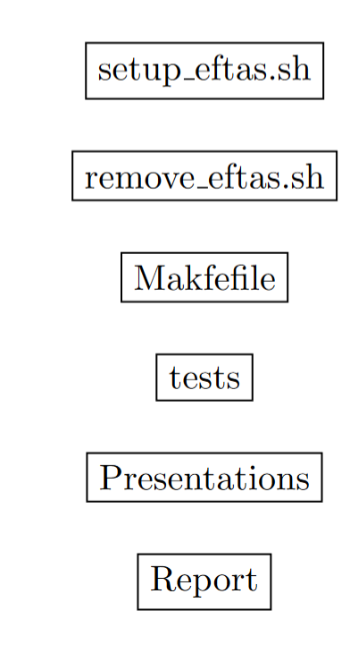
/File System Extension/Solution.c
Usage: $0 {help|mkfile|tagFile|ls|deleteTag|newTag|showAllTags}
Places
Recent
Home
Desktop
Documents
Downloads
Music
Pictures
Videos
Trash
Devices
Computer
Network
Connect to Server
Usage: eftas {help|mkfile|tagFile|ls|deleteTag|listAll|newTag|showAllTags}

Slide 5

/File System Extension/Demonstration.mp4
Places
Recent
Home
Desktop
Documents
Downloads
Music
Pictures
Videos
Trash
Devices
Computer
Network
Connect to Server

Slide 6


/File System Extension/Disscussion.txt
Places
Recent
Home
Desktop
Documents
Downloads
Music
Pictures
Videos
Trash
Devices
Computer
Network
Connect to Server
What we accomplished
Provide an interface to manipulate, manage and filter by filetags
Where we could go from here
Apply file operations based on tags (e.g. file permission)
Graphical representation of tagging system

Slide 7


/File System Extension/Lessons_Learned.txt
Places
Recent
Home
Desktop
Documents
Downloads
Music
Pictures
Videos
Trash
Devices
Computer
Network
Connect to Server
Good teamwork
Protocoll what you do, while you’re doing it
Can be difficult to find the source that led to a solution again
Good teamwork
Inform Partner of changes
Regularly check up on current status and time plan
Workflow improvements
Make note of solution steps / helpful information
Later on more comprehensible what was done, and it can be recreated

